Slide 1
Topological sort

Slide 2
Topological Sort
In this topic, we will discuss:
Motivations
Review the definition of a directed acyclic graph (DAG)
Describe a topological sort and applications
Prove the existence of topological sorts on DAGs
Describe an abstract algorithm for a topological sort
Do a run-time and memory analysis of the algorithm
Describe a concrete algorithm
Define critical times and critical paths

Slide 3
Motivation
11.4.1
Given a set of tasks with dependencies,
is there an order in which we can complete the tasks?
Dependencies form a partial ordering
A partial ordering on a finite number of objects can be represented as a directed acyclic graph (DAG)

Slide 4
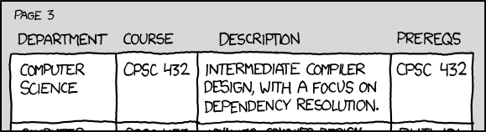
Motivation
11.4.1
http://xkcd.com/754/
Cycles in dependencies can cause issues...

Slide 5
Restriction of paths in DAGs
11.4.2
In a DAG, given two different vertices v_{j} and v_{k}, there cannot both be a path from v_{j} to v_{k} and a path from v_{k} to v_{j}
Proof:
Assume otherwise; thus there exists two paths:
(v_{j}, v_{1,1}, v_{1,2} , v_{1,3} , … , v_{k})
(v_{k}, v_{2,1}, v_{2,2} , v_{2,3} , … , v_{j})
From this, we can construct the path
(v_{j}, v_{1,1}, v_{1,2} , v_{1,3} , … , v_{k}, v_{2,1}, v_{2,2} , v_{2,3} , … , v_{j})
This a path is a cycle, but this is an acyclic graph
∴ contradiction

Slide 6
Definition of topological sorting
11.4.3
A topological sorting of the vertices in a DAG is an ordering
v₁, v₂, v₃, …, v_{|V|}
such that v_{j} appears before v_{k} if there is a path from v_{j} to v_{k}

Slide 7
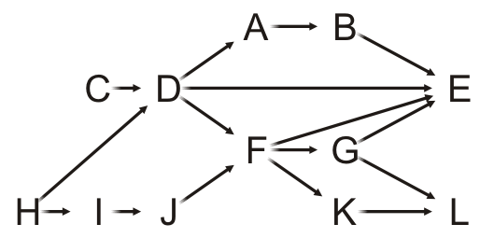
Definition of topological sorting
11.4.3
Given this DAG, a topological sort is
H, C, I, D, J, A, F, B, G, K, E, L

Slide 8
Example
11.4.3
For example, there are paths from H, C, I, D and J to F, so all these must come before F in a topological sort
H, C, I, D, J, A, F, B, G, K, E, L
Clearly, this sorting need not be unique

Slide 9
Applications
11.4.3
Consider the course instructor getting ready for a dinner out
He must wear the following:
jacket, shirt, briefs, socks, tie, etc.
There are certain constraints:
the pants really should go on after the briefs,
socks are put on before shoes
http://www.idealliance.org/proceedings/xml03/slides/mansfield&otkunc/Paper/03-02-04.html

Slide 10
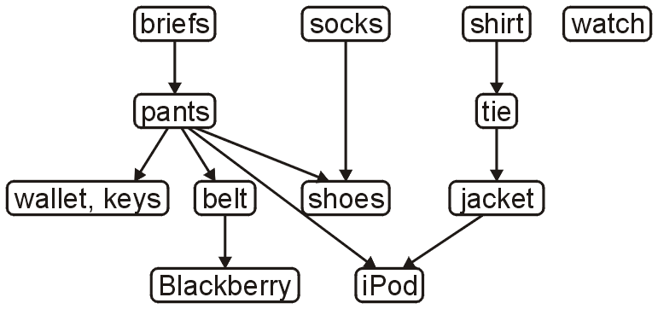
Applications
11.4.3
The following is a task graph for getting dressed:
One topological sort is:
briefs, pants, wallet, keys, belt, socks, shoes, shirt, tie, jacket, iPod, watch
A more reasonable topological sort is:
briefs, socks, pants, shirt, belt, tie, jacket, wallet, keys, iPod, watch, shoes

Slide 11
Applications
11.4.3
C++ header and source files have #include statements
A change to an included file requires a recompilation of the current file
On a large project, it is desirable to recompile only those source files that depended on those files which changed
For large software projects, full compilations may take hours

Slide 12
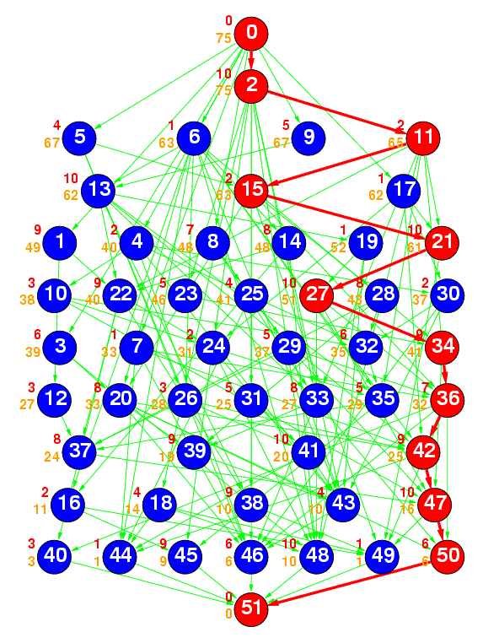
Applications
11.4.3
Ref: The Standard Task Graph
http://www.kasahara.elec.waseda.ac.jp/schedule/
The following is a DAG
representing a number of tasks
The green arrows represent dependencies
The numbering indicates a topological sort of the tasks

Slide 13
Topological Sort
11.4.4
Theorem:
A graph is a DAG if and only if it has a topological sorting
Proof strategy:
Such a statement is of the form a ↔ b and this is equivalent to:
a → b and b → a

Slide 14
Topological Sort
11.4.4
First, we need a two lemmas:
A DAG always has at least one vertex with in-degree zero
That is, it has at least one source
Proof:
If we cannot find a vertex with in-degree zero, we will show there must be a cycle
Start with any vertex and define a list L = (v)
Then iterate this loop |V| times:
Given the list L, the first vertex ℓ₁ does not have in-degree zero
Find any vertex w such that (w, ℓ₁) is an edge
Create a new list L = (w, ℓ₁, …, ℓ_{k})
By the pigeon-hole principle, at least one vertex must appear twice
This forms a cycle; hence a contradiction, as this is a DAG
∴ we can always find a vertex with in-degree zero

Slide 15
Topological Sort
11.4.4
First, we need a two lemmas:
Any sub-graph of a DAG is a DAG
Proof:
If a sub-graph has a cycle, that same cycle must appear in the super-graph
We assumed the super-graph was a DAG
This is a contradiction
∴ the sub-graph must be a DAG

Slide 16
Topological Sort
11.4.4
We will start with showing a → b:
If a graph is a DAG, it has a topological sort
By induction:
A graph with one vertex is a DAG and it has a topological sort
Assume a DAG with n vertices has a topological sort
A DAG with n + 1 vertices must have at least one vertex v of in-degree zero
Removing the vertex v and consider the vertex-induced sub-graph with the remaining n vertices
If this sub-graph has a cycle, so would the original graph—contradiction
Thus, the graph with n vertices is also a DAG, therefore it has a topological sort
Add the vertex v to the start of the topological sort to get one for the graph of size n + 1

Slide 17
Topological Sort
11.4.4
Next, we will show that b → a:
If a graph has a topological ordering, it must be a DAG
We will show this by showing the contrapositive: ¬a → ¬b:
If a graph is not a DAG, it does not have a topological sort
By definition, it has a cycle: (v₁, v₂, v₃, …, v_{k}, v₁)
In any topological sort, v₁ must appear before v₂, because (v₁, v₂) is a path
However, there is also a path from v₂ to v₁: (v₂, v₃, …, v_{k}, v₁)
Therefore, v₂ must appear in the topological sort before v₁
This is a contradiction, therefore the graph cannot have a topological sort
∴ A graph is a DAG if and only if it has a topological sorting

Slide 18
Topological Sort
11.4.5
Idea:
Given a DAG V, make a copy W and iterate:
Find a vertex v in W with in-degree zero
Let v be the next vertex in the topological sort
Continue iterating with the vertex-induced sub-graph W \ {v}

Slide 19
Example
11.4.5.1
On this graph, iterate the following |V| = 12 times
Choose a vertex v that has in-degree zero
Let v be the next vertex in our topological sort
Remove v and all edges connected to it

Slide 20
Example
11.4.5.1
Let’s step through this algorithm with this example
Which task can we start with?

Slide 21
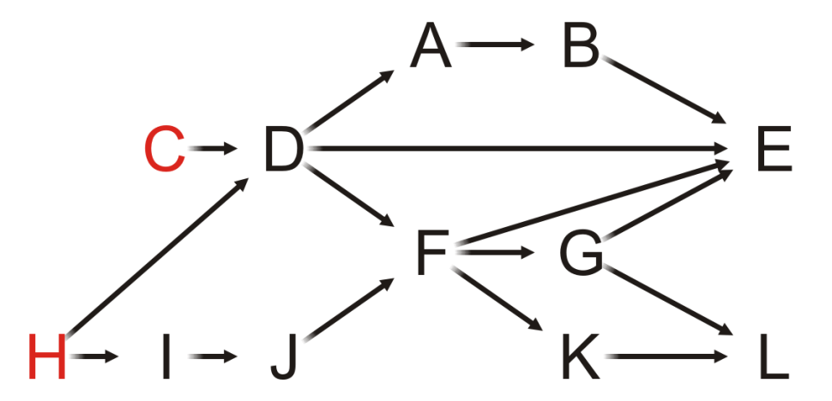
Example
11.4.5.1
Of Tasks C or H, choose Task C

Slide 22
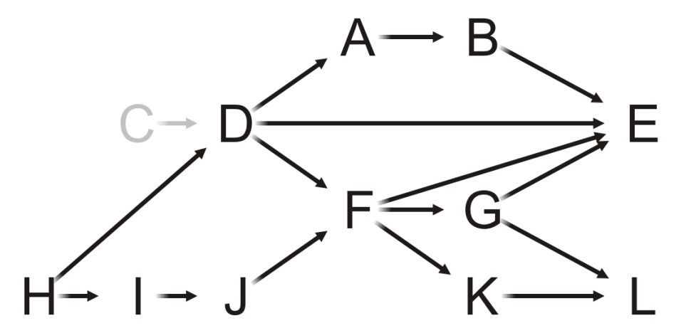
Example
11.4.5.1
Having completed Task C, which vertices have in-degree zero?
C

Slide 23
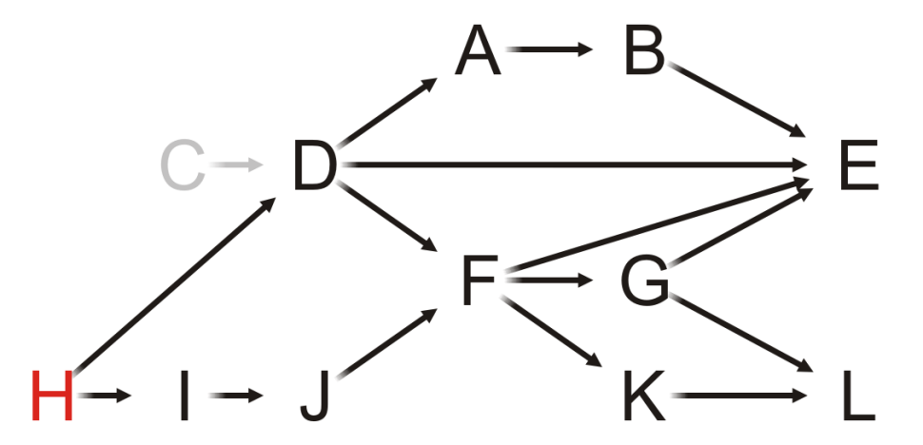
Example
11.4.5.1
Only Task H can be completed, so we choose it
C

Slide 24
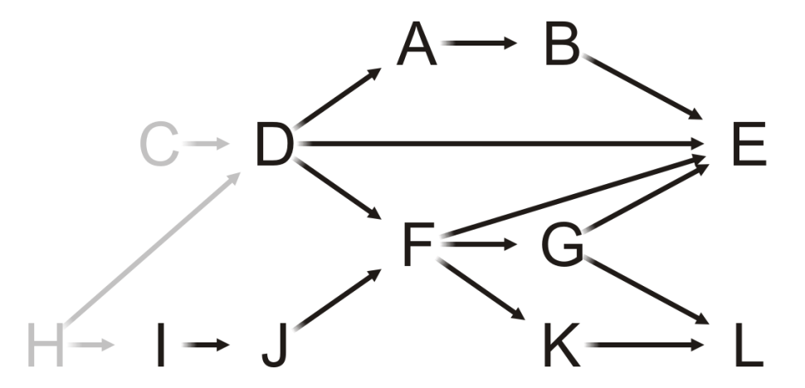
Example
11.4.5.1
Having removed H, what is next?
C, H

Slide 25
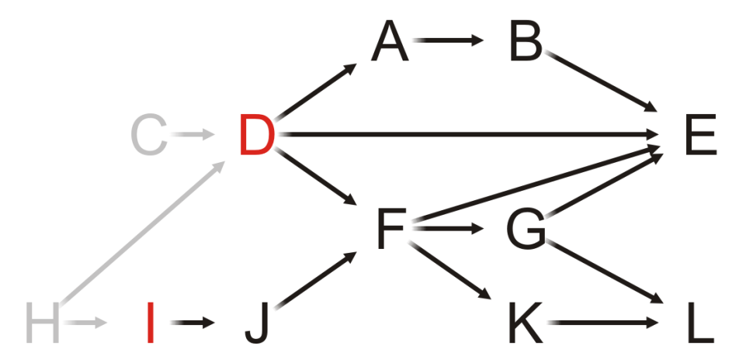
Example
11.4.5.1
Both Tasks D and I have in-degree zero
Let us choose Task D
C, H

Slide 26
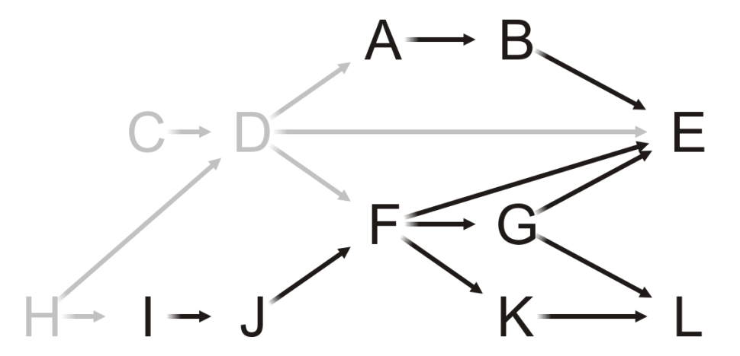
Example
11.4.5.1
We remove Task D, and now?
C, H, D

Slide 27
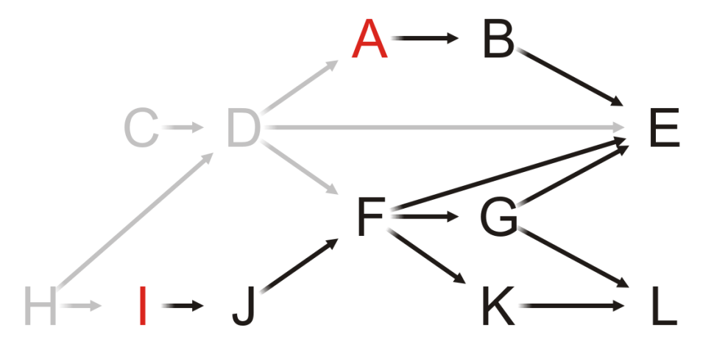
Example
11.4.5.1
C, H, D
Both Tasks A and I have in-degree zero
Let’s choose Task A

Slide 28
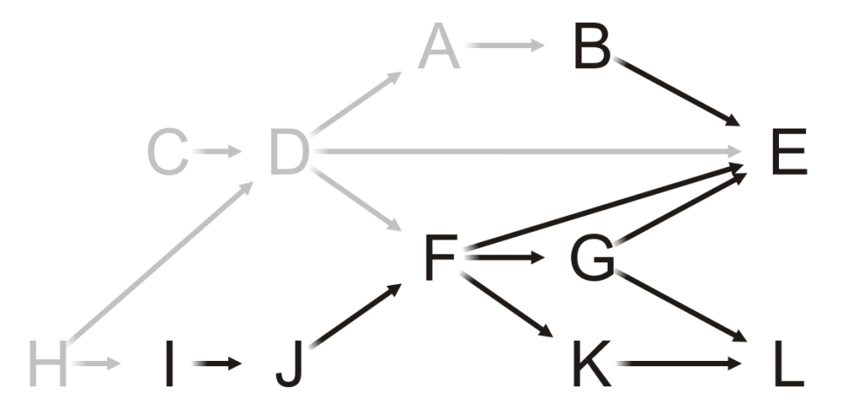
Example
11.4.5.1
C, H, D, A
Having removed A, what now?

Slide 29
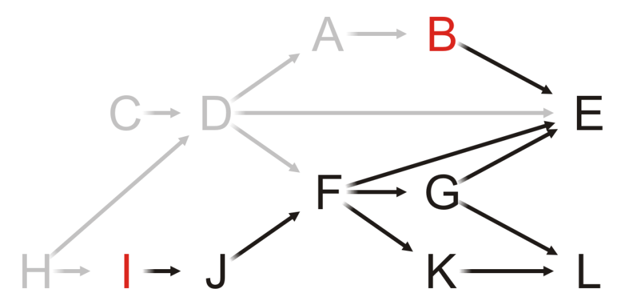
Example
11.4.5.1
C, H, D, A
Both Tasks B and I have in-degree zero
Choose Task B

Slide 30
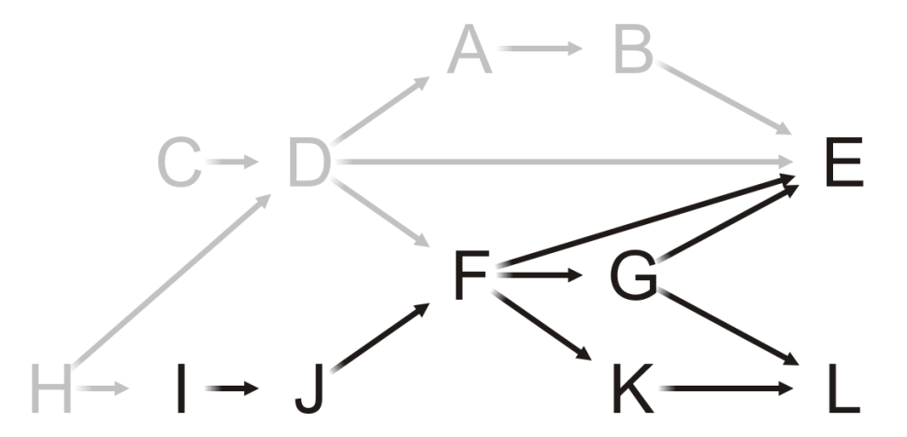
Example
11.4.5.1
C, H, D, A, B
Removing Task B, we note that Task E still has an in-degree of two
Next?

Slide 31
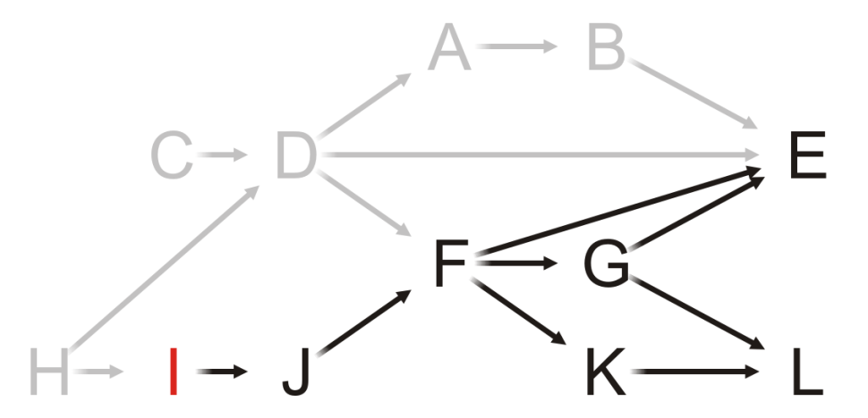
Example
11.4.5.1
C, H, D, A, B
As only Task I has in-degree zero, we choose it

Slide 32
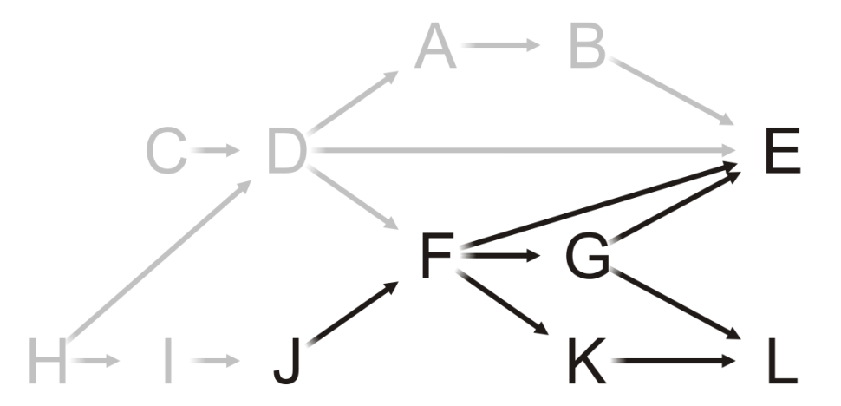
Example
11.4.5.1
C, H, D, A, B, I
Having completed Task I, what now?

Slide 33
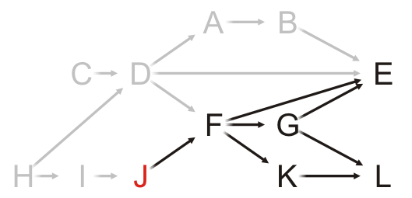
Example
11.4.5.1
C, H, D, A, B, I
Only Task J has in-degree zero: choose it

Slide 34
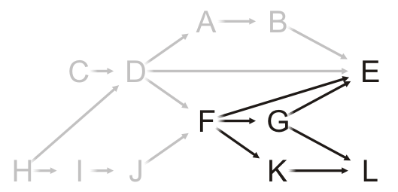
Example
11.4.5.1
C, H, D, A, B, I, J
Having completed Task J, what now?

Slide 35
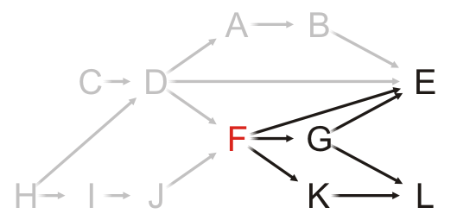
Example
11.4.5.1
C, H, D, A, B, I, J
Only Task F can be completed, so choose it

Slide 36
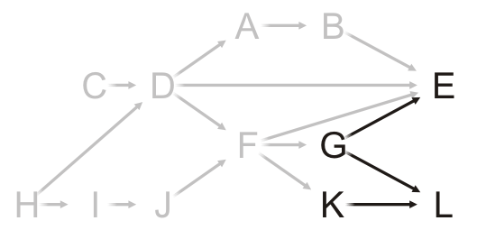
Example
11.4.5.1
C, H, D, A, B, I, J, F
What choices do we have now?

Slide 37
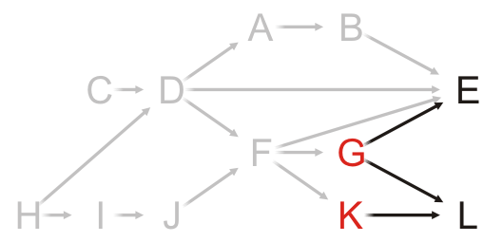
Example
11.4.5.1
C, H, D, A, B, I, J, F
We can perform Tasks G or K
Choose Task G

Slide 38
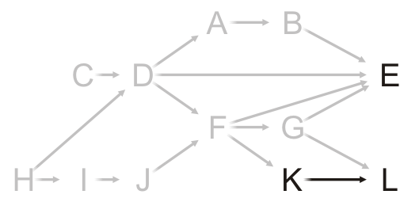
Example
11.4.5.1
C, H, D, A, B, I, J, F, G
Having removed Task G from the graph, what next?

Slide 39
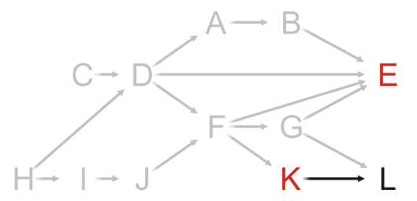
Example
11.4.5.1
C, H, D, A, B, I, J, F, G
Choosing between Tasks E and K, choose Task E

Slide 40
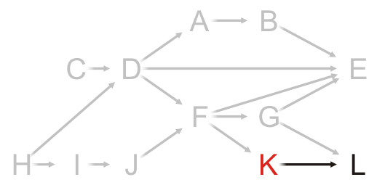
Example
11.4.5.1
C, H, D, A, B, I, J, F, G, E
At this point, Task K is the only one that can be run

Slide 41
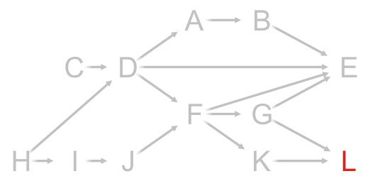
Example
11.4.5.1
C, H, D, A, B, I, J, F, G, E, K
And now that both Tasks G and K are complete, we can complete Task L

Slide 42
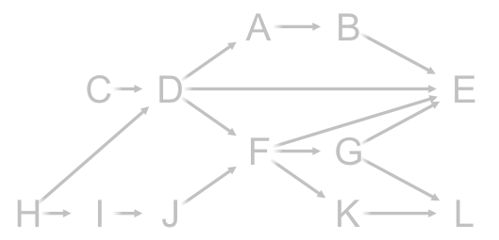
Example
11.4.5.1
C, H, D, A, B, I, J, F, G, E, K, L
There are no more vertices left

Slide 43
Example
11.4.5.1
Thus, one possible topological sort would be:
C, H, D, A, B, I, J, F, G, E, K, L

Slide 44
Example
11.4.5.1
Note that topological sorts need not be unique:
C, H, D, A, B, I, J, F, G, E, K, L
H, I, J, C, D, F, G, K, L, A, B, E

Slide 45
Analysis
11.4.6
What are the tools necessary for a topological sort?
We must know and be able to update the in-degrees of each of the vertices
We could do this with a table of the in-degrees of each of the vertices
This requires Θ(|V|) memory
A | 1
B | 1
C | 0
D | 2
E | 4
F | 2
G | 1
H | 0
I | 1
J | 1
K | 1
L | 2

Slide 46
Analysis
11.4.6
We must iterate at least |V| times, so the run-time must be Ω(|V|)
A | 1
B | 1
C | 0
D | 2
E | 4
F | 2
G | 1
H | 0
I | 1
J | 1
K | 1
L | 2

Slide 47
Analysis
11.4.6
We need to find vertices with in-degree zero
We could loop through the array with each iteration
The run time would be O(|V|²)
A | 1
B | 1
C | 0
D | 2
E | 4
F | 2
G | 1
H | 0
I | 1
J | 1
K | 1
L | 2

Slide 48
Analysis
11.4.6
What did we do with tree traversals?
Use a queue (or other container) to temporarily store those vertices with in-degree zero
Each time the in-degree of a vertex is decremented to zero, push it onto the queue
A | 1
B | 1
C | 0
D | 2
E | 4
F | 2
G | 1
H | 0
I | 1
J | 1
K | 1
L | 2

Slide 49
Analysis
11.4.6
What are the run times associated with the queue?
Initially, we must scan through each of the vertices: Θ(|V|)
For each vertex, we will have to push onto and pop off the queue once, also Θ(|V|)
A | 1
B | 1
C | 0
D | 2
E | 4
F | 2
G | 1
H | 0
I | 1
J | 1
K | 1
L | 2

Slide 50
Analysis
11.4.6
Finally, each value in the in-degree table is associated with an edge
Here, |E| = 16
Each of the in-degrees must be decremented to zero
The run time of these operations is Ω(|E|)
If we are using an adjacency matrix: Θ(|V|²)
If we are using an adjacency list: Θ(|E|)
A | 1
B | 1
C | 0
D | 2
E | 4
F | 2
G | 1
H | 0
I | 1
J | 1
K | 1
L | 2
+
16

Slide 51
Analysis
11.4.6
Therefore, the run time of a topological sort is:
Θ(|V| + |E|) if we use an adjacency list
Θ(|V|²) if we use an adjacency matrix
and the memory requirements is Θ(|V|)
A | 1
B | 1
C | 0
D | 2
E | 4
F | 2
G | 1
H | 0
I | 1
J | 1
K | 1
L | 2

Slide 52
Analysis
11.4.6
What happens if at some step, all remaining vertices have an in-degree greater than zero?
There must be at least one cycle within that sub-set of vertices
Consequence: we now have an Θ(|V| + |E|) algorithm for determining if a graph has a cycle
A | 1
B | 1
C | 0
D | 2
E | 4
F | 2
G | 1
H | 0
I | 1
J | 1
K | 1
L | 2

Slide 53
Implementation
11.4.7
Thus, to implement a topological sort:
Allocate memory for and initialize an array of in-degrees
Create a queue and initialize it with all vertices that have in-degree zero
While the queue is not empty:
Pop a vertex from the queue
Decrement the in-degree of each neighbor
Those neighbors whose in-degree was decremented to zero are pushed onto the queue

Slide 54
Implementation
11.4.7
We will, however, use a trick with our queue
Initialization
Type array[vertex_size()];
int ihead = 0, itail = -1;
Testing if empty:
ihead == itail + 1
For push
++itail;
array[itail] = next vertex;
For pop
Type current_top = array[ihead];
++ihead;

Slide 55
Implementation
11.4.7
Because we place each vertex into the queue exactly once
We must never resize the array
We do not have to worry about the queue cycling
Most importantly, however, because of the properties of a queue
When we finish, the underlying array stores the topological sort

Slide 56
Example
With the previous example, we initialize:
The array of in-degrees
The queue
A | 1
B | 1
C | 0
D | 2
E | 4
F | 2
G | 1
H | 0
I | 1
J | 1
K | 1
L | 2
Queue:
The queue is empty

Slide 57
Example
Stepping through the table, push all source vertices into the queue
A | 1
B | 1
C | 0
D | 2
E | 4
F | 2
G | 1
H | 0
I | 1
J | 1
K | 1
L | 2
Queue:
The queue is empty

Slide 58
Example
Stepping through the table, push all source vertices into the queue
A | 1
B | 1
C | 0
D | 2
E | 4
F | 2
G | 1
H | 0
I | 1
J | 1
K | 1
L | 2
Queue:
C | H
The queue is empty

Slide 59
Example
Pop the front of the queue
A | 1
B | 1
C | 0
D | 2
E | 4
F | 2
G | 1
H | 0
I | 1
J | 1
K | 1
L | 2
Queue:
C | H

Slide 60
Example
Pop the front of the queue
C has one neighbor: D
A | 1
B | 1
C | 0
D | 2
E | 4
F | 2
G | 1
H | 0
I | 1
J | 1
K | 1
L | 2
Queue:
C | H

Slide 61
Example
Pop the front of the queue
C has one neighbor: D
Decrement its in-degree
A | 1
B | 1
C | 0
D | 1
E | 4
F | 2
G | 1
H | 0
I | 1
J | 1
K | 1
L | 2
Queue:
C | H

Slide 62
Example
Pop the front of the queue
A | 1
B | 1
C | 0
D | 1
E | 4
F | 2
G | 1
H | 0
I | 1
J | 1
K | 1
L | 2
Queue:
C | H

Slide 63
Example
Pop the front of the queue
H has two neighbors: D and I
A | 1
B | 1
C | 0
D | 1
E | 4
F | 2
G | 1
H | 0
I | 1
J | 1
K | 1
L | 2
Queue:
C | H

Slide 64
Example
Pop the front of the queue
H has two neighbors: D and I
Decrement their in-degrees
A | 1
B | 1
C | 0
D | 0
E | 4
F | 2
G | 1
H | 0
I | 0
J | 1
K | 1
L | 2
Queue:
C | H

Slide 65
Example
Pop the front of the queue
H has two neighbors: D and I
Decrement their in-degrees
Both are decremented to zero, so push them onto the queue
A | 1
B | 1
C | 0
D | 0
E | 4
F | 2
G | 1
H | 0
I | 0
J | 1
K | 1
L | 2
Queue:
C | H

Slide 66
Example
Pop the front of the queue
H has two neighbors: D and I
Decrement their in-degrees
Both are decremented to zero, so push them onto the queue
A | 1
B | 1
C | 0
D | 0
E | 4
F | 2
G | 1
H | 0
I | 0
J | 1
K | 1
L | 2
Queue:
C | H | D | I

Slide 67
Example
Pop the front of the queue
A | 1
B | 1
C | 0
D | 0
E | 4
F | 2
G | 1
H | 0
I | 0
J | 1
K | 1
L | 2
Queue:
C | H | D | I

Slide 68
Example
Pop the front of the queue
D has three neighbors: A, E and F
A | 1
B | 1
C | 0
D | 0
E | 4
F | 2
G | 1
H | 0
I | 0
J | 1
K | 1
L | 2
Queue:
C | H | D | I

Slide 69
Example
Pop the front of the queue
D has three neighbors: A, E and F
Decrement their in-degrees
A | 0
B | 1
C | 0
D | 0
E | 3
F | 1
G | 1
H | 0
I | 0
J | 1
K | 1
L | 2
Queue:
C | H | D | I

Slide 70
Example
Pop the front of the queue
D has three neighbors: A, E and F
Decrement their in-degrees
A is decremented to zero, so push it onto the queue
A | 0
B | 1
C | 0
D | 0
E | 3
F | 1
G | 1
H | 0
I | 0
J | 1
K | 1
L | 2
Queue:
C | H | D | I | A

Slide 71
Example
Pop the front of the queue
A | 0
B | 1
C | 0
D | 0
E | 3
F | 1
G | 1
H | 0
I | 0
J | 1
K | 1
L | 2
Queue:
C | H | D | I | A

Slide 72
Example
Pop the front of the queue
I has one neighbor: J
A | 0
B | 1
C | 0
D | 0
E | 3
F | 1
G | 1
H | 0
I | 0
J | 1
K | 1
L | 2
Queue:
C | H | D | I | A

Slide 73
Example
Pop the front of the queue
I has one neighbor: J
Decrement its in-degree
A | 0
B | 1
C | 0
D | 0
E | 3
F | 1
G | 1
H | 0
I | 0
J | 0
K | 1
L | 2
Queue:
C | H | D | I | A

Slide 74
Example
Pop the front of the queue
I has one neighbor: J
Decrement its in-degree
J is decremented to zero, so push it onto the queue
A | 0
B | 1
C | 0
D | 0
E | 3
F | 1
G | 1
H | 0
I | 0
J | 0
K | 1
L | 2
Queue:
C | H | D | I | A | J

Slide 75
Example
Pop the front of the queue
A | 0
B | 1
C | 0
D | 0
E | 3
F | 1
G | 1
H | 0
I | 0
J | 0
K | 1
L | 2
Queue:
C | H | D | I | A | J

Slide 76
Example
Pop the front of the queue
A has one neighbor: B
A | 0
B | 1
C | 0
D | 0
E | 3
F | 1
G | 1
H | 0
I | 0
J | 0
K | 1
L | 2
Queue:
C | H | D | I | A | J

Slide 77
Example
Pop the front of the queue
A has one neighbor: B
Decrement its in-degree
A | 0
B | 0
C | 0
D | 0
E | 3
F | 1
G | 1
H | 0
I | 0
J | 0
K | 1
L | 2
Queue:
C | H | D | I | A | J

Slide 78
Example
Pop the front of the queue
A has one neighbor: B
Decrement its in-degree
B is decremented to zero, so push it onto the queue
A | 0
B | 0
C | 0
D | 0
E | 3
F | 1
G | 1
H | 0
I | 0
J | 0
K | 1
L | 2
Queue:
C | H | D | I | A | J | B

Slide 79
Example
Pop the front of the queue
A | 0
B | 0
C | 0
D | 0
E | 3
F | 1
G | 1
H | 0
I | 0
J | 0
K | 1
L | 2
Queue:
C | H | D | I | A | J | B

Slide 80
Example
Pop the front of the queue
J has one neighbor: F
A | 0
B | 0
C | 0
D | 0
E | 3
F | 1
G | 1
H | 0
I | 0
J | 0
K | 1
L | 2
Queue:
C | H | D | I | A | J | B

Slide 81
Example
Pop the front of the queue
J has one neighbor: F
Decrement its in-degree
A | 0
B | 0
C | 0
D | 0
E | 3
F | 0
G | 1
H | 0
I | 0
J | 0
K | 1
L | 2
Queue:
C | H | D | I | A | J | B

Slide 82
Example
Pop the front of the queue
J has one neighbor: F
Decrement its in-degree
F is decremented to zero, so push it onto the queue
A | 0
B | 0
C | 0
D | 0
E | 3
F | 0
G | 1
H | 0
I | 0
J | 0
K | 1
L | 2
Queue:
C | H | D | I | A | J | B | F

Slide 83
Example
Pop the front of the queue
A | 0
B | 0
C | 0
D | 0
E | 3
F | 0
G | 1
H | 0
I | 0
J | 0
K | 1
L | 2
Queue:
C | H | D | I | A | J | B | F

Slide 84
Example
Pop the front of the queue
B has one neighbor: E
A | 0
B | 0
C | 0
D | 0
E | 3
F | 0
G | 1
H | 0
I | 0
J | 0
K | 1
L | 2
Queue:
C | H | D | I | A | J | B | F

Slide 85
Example
Pop the front of the queue
B has one neighbor: E
Decrement its in-degree
A | 0
B | 0
C | 0
D | 0
E | 2
F | 0
G | 1
H | 0
I | 0
J | 0
K | 1
L | 2
Queue:
C | H | D | I | A | J | B | F

Slide 86
Example
Pop the front of the queue
A | 0
B | 0
C | 0
D | 0
E | 2
F | 0
G | 1
H | 0
I | 0
J | 0
K | 1
L | 2
Queue:
C | H | D | I | A | J | B | F

Slide 87
Example
Pop the front of the queue
F has three neighbors: E, G and K
A | 0
B | 0
C | 0
D | 0
E | 2
F | 0
G | 1
H | 0
I | 0
J | 0
K | 1
L | 2
Queue:
C | H | D | I | A | J | B | F

Slide 88
Example
Pop the front of the queue
F has three neighbors: E, G and K
Decrement their in-degrees
A | 0
B | 0
C | 0
D | 0
E | 1
F | 0
G | 0
H | 0
I | 0
J | 0
K | 0
L | 2
Queue:
C | H | D | I | A | J | B | F

Slide 89
Example
Pop the front of the queue
F has three neighbors: E, G and K
Decrement their in-degrees
G and K are decremented to zero, so push them onto the queue
A | 0
B | 0
C | 0
D | 0
E | 1
F | 0
G | 0
H | 0
I | 0
J | 0
K | 0
L | 2
Queue:
C | H | D | I | A | J | B | F | G | K

Slide 90
Example
Pop the front of the queue
A | 0
B | 0
C | 0
D | 0
E | 1
F | 0
G | 0
H | 0
I | 0
J | 0
K | 0
L | 2
Queue:
C | H | D | I | A | J | B | F | G | K

Slide 91
Example
Pop the front of the queue
G has two neighbors: E and L
A | 0
B | 0
C | 0
D | 0
E | 1
F | 0
G | 0
H | 0
I | 0
J | 0
K | 0
L | 2
Queue:
C | H | D | I | A | J | B | F | G | K

Slide 92
Example
Pop the front of the queue
G has two neighbors: E and L
Decrement their in-degrees
A | 0
B | 0
C | 0
D | 0
E | 0
F | 0
G | 0
H | 0
I | 0
J | 0
K | 0
L | 1
Queue:
C | H | D | I | A | J | B | F | G | K

Slide 93
Example
Pop the front of the queue
G has two neighbors: E and L
Decrement their in-degrees
E is decremented to zero, so push it onto the queue
A | 0
B | 0
C | 0
D | 0
E | 0
F | 0
G | 0
H | 0
I | 0
J | 0
K | 0
L | 1
Queue:
C | H | D | I | A | J | B | F | G | K | E

Slide 94
Example
Pop the front of the queue
A | 0
B | 0
C | 0
D | 0
E | 0
F | 0
G | 0
H | 0
I | 0
J | 0
K | 0
L | 1
Queue:
C | H | D | I | A | J | B | F | G | K | E

Slide 95
Example
Pop the front of the queue
K has one neighbors: L
A | 0
B | 0
C | 0
D | 0
E | 0
F | 0
G | 0
H | 0
I | 0
J | 0
K | 0
L | 1
Queue:
C | H | D | I | A | J | B | F | G | K | E

Slide 96
Example
Pop the front of the queue
K has one neighbors: L
Decrement its in-degree
A | 0
B | 0
C | 0
D | 0
E | 0
F | 0
G | 0
H | 0
I | 0
J | 0
K | 0
L | 0
Queue:
C | H | D | I | A | J | B | F | G | K | E

Slide 97
Example
Pop the front of the queue
K has one neighbors: L
Decrement its in-degree
L is decremented to zero, so push it onto the queue
A | 0
B | 0
C | 0
D | 0
E | 0
F | 0
G | 0
H | 0
I | 0
J | 0
K | 0
L | 0
Queue:
C | H | D | I | A | J | B | F | G | K | E | L

Slide 98
Example
Pop the front of the queue
A | 0
B | 0
C | 0
D | 0
E | 0
F | 0
G | 0
H | 0
I | 0
J | 0
K | 0
L | 0
Queue:
C | H | D | I | A | J | B | F | G | K | E | L

Slide 99
Example
Pop the front of the queue
E has no neighbors—it is a sink
A | 0
B | 0
C | 0
D | 0
E | 0
F | 0
G | 0
H | 0
I | 0
J | 0
K | 0
L | 0
Queue:
C | H | D | I | A | J | B | F | G | K | E | L

Slide 100
Example
Pop the front of the queue
A | 0
B | 0
C | 0
D | 0
E | 0
F | 0
G | 0
H | 0
I | 0
J | 0
K | 0
L | 0
Queue:
C | H | D | I | A | J | B | F | G | K | E | L

Slide 101
Example
Pop the front of the queue
L has no neighbors—it is also a sink
A | 0
B | 0
C | 0
D | 0
E | 0
F | 0
G | 0
H | 0
I | 0
J | 0
K | 0
L | 0
Queue:
C | H | D | I | A | J | B | F | G | K | E | L

Slide 102
Example
The queue is empty, so we are done
A | 0
B | 0
C | 0
D | 0
E | 0
F | 0
G | 0
H | 0
I | 0
J | 0
K | 0
L | 0
Queue:
C | H | D | I | A | J | B | F | G | K | E | L

Slide 103
Example
We deallocate the memory for the temporary in-degree array
The array stores the topological sorting
A | 0
B | 0
C | 0
D | 0
E | 0
F | 0
G | 0
H | 0
I | 0
J | 0
K | 0
L | 0
C | H | D | I | A | J | B | F | G | K | E | L

Slide 104
Example
We deallocate the memory for the temporary in-degree array
The array used for the queue stores the topological sort
Note the difference in order from our previous sort?
C, H, D, A, B, I, J, F, G, E, K, L
A | 0
B | 0
C | 0
D | 0
E | 0
F | 0
G | 0
H | 0
I | 0
J | 0
K | 0
L | 0
C | H | D | I | A | J | B | F | G | K | E | L

Slide 105
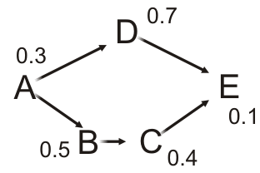

Critical path
11.4.8
Suppose each task has a performance time associated with it
If the tasks are performed serially, the time required to complete the last task equals to the sum of the individual task times
These tasks require 0.3 + 0.7 + 0.5 + 0.4 + 0.1 = 2.0 s to execute serially

Slide 106
Critical path
11.4.8
Suppose two tasks are ready to execute
We could perform these tasks in parallel
Computer tasks can be executed in parallel (multi-processing)
Different tasks can be completed by different teams in a company

Slide 107
Critical path
11.4.8
Suppose Task A completes
We can now execute Tasks B and D in parallel
However, Task E cannot execute until Task C completes, and Task C cannot execute until Task B completes
The least time in which these five tasks can be completed is 0.3 + 0.5 + 0.4 + 0.1 = 1.3 s
This is called the critical time of all tasks
The path (A, B, C, E) is said to be the critical path

Slide 108
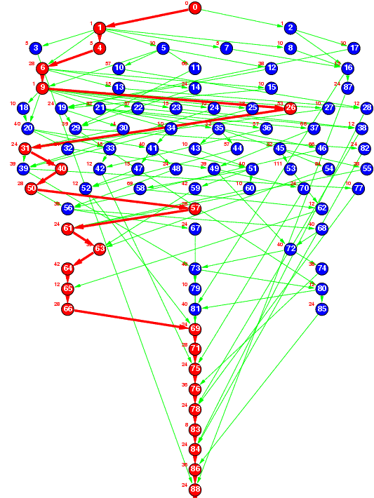
Critical path
11.4.8
Ref: The Standard Task Graph
http://www.kasahara.elec.waseda.ac.jp/schedule/
The program described previously shows the critical path in red
We will define the critical time of each task to be the earliest time that it could be completed after the start of execution

Slide 109
Finding the critical path
11.4.8
Tasks that have no prerequisites have a critical time equal to the time it takes to complete that task
For tasks that depend on others, the critical time will be:
The maximum critical time that it takes to complete a prerequisite
Plus the time it takes to complete this task
In this example, the critical times are:
Task A completes in 0.3 s
Task B must wait for A and completes after 0.8 s
Task D must wait for A and completes after 1.0 s
Task C must wait for B and completes after 1.2 s
Task E must wait for both C and D, and completes after max(1.0, 1.2) + 0.1 = 1.3 s

Slide 110
Finding the critical path
11.4.8.1
Thus, we require more information:
We must know the execution time of each task
We will have to record the critical time for each task
Initialize these to zero
We will need to know the previous task with the longest critical time to determine the critical path
Set these to null

Slide 111
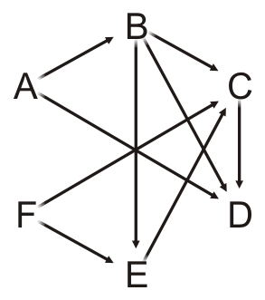
Finding the critical path
11.4.8.2
Task | In-degree | Task Time | Critical Time | Previous Task
A | 0 | 5.2 | 0.0 | Ø
B | 1 | 6.1 | 0.0 | Ø
C | 3 | 4.7 | 0.0 | Ø
D | 3 | 8.1 | 0.0 | Ø
E | 2 | 9.5 | 0.0 | Ø
F | 0 | 17.1 | 0.0 | Ø
Queue
Suppose we have the following times for the tasks

Slide 112
Finding the critical path
11.4.8.2
Each time we pop a vertex v, in addition to what we already do:
For v, add the task time onto the critical time for that vertex:
That is the critical time for v
For each adjacent vertex w:
If the critical time for v is greater than the currently stored critical time for w
Update the critical time with the critical time for v
Set the previous pointer to the vertex v

Slide 113
Finding the critical path
11.4.8.2
Task | In-degree | Task Time | Critical Time | Previous Task
A | 0 | 5.2 | 0.0 | Ø
B | 1 | 6.1 | 0.0 | Ø
C | 3 | 4.7 | 0.0 | Ø
D | 3 | 8.1 | 0.0 | Ø
E | 2 | 9.5 | 0.0 | Ø
F | 0 | 17.1 | 0.0 | Ø
Queue
A | F
So we initialize the queue with those vertices with in-degree zero

Slide 114
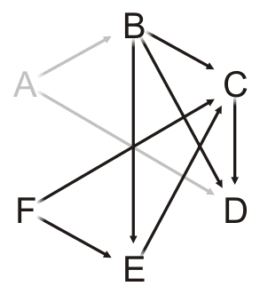
Finding the critical path
11.4.8.2
Task | In-degree | Task Time | Critical Time | Previous Task
A | 0 | 5.2 | 0.0 | Ø
B | 1 | 6.1 | 0.0 | Ø
C | 3 | 4.7 | 0.0 | Ø
D | 3 | 8.1 | 0.0 | Ø
E | 2 | 9.5 | 0.0 | Ø
F | 0 | 17.1 | 0.0 | Ø
Queue
F
Pop Task A and update its critical time 0.0 + 5.2 = 5.2

Slide 115
Finding the critical path
11.4.8.2
Task | In-degree | Task Time | Critical Time | Previous Task
A | 0 | 5.2 | 5.2 | Ø
B | 1 | 6.1 | 0.0 | Ø
C | 3 | 4.7 | 0.0 | Ø
D | 3 | 8.1 | 0.0 | Ø
E | 2 | 9.5 | 0.0 | Ø
F | 0 | 17.1 | 0.0 | Ø
Queue
F
Pop Task A and update its critical time 0.0 + 5.2 = 5.2

Slide 116
Finding the critical path
11.4.8.2
Task | In-degree | Task Time | Critical Time | Previous Task
A | 0 | 5.2 | 5.2 | Ø
B | 1 | 6.1 | 0.0 | Ø
C | 3 | 4.7 | 0.0 | Ø
D | 3 | 8.1 | 0.0 | Ø
E | 2 | 9.5 | 0.0 | Ø
F | 0 | 17.1 | 0.0 | Ø
Queue
F
For each neighbor of Task A:
Decrement the in-degree, push if necessary, and check if we must update the critical time

Slide 117
Finding the critical path
11.4.8.2
Task | In-degree | Task Time | Critical Time | Previous Task
A | 0 | 5.2 | 5.2 | Ø
B | 0 | 6.1 | 5.2 | A
C | 3 | 4.7 | 0.0 | Ø
D | 2 | 8.1 | 5.2 | A
E | 2 | 9.5 | 0.0 | Ø
F | 0 | 17.1 | 0.0 | Ø
Queue
F | B
For each neighbor of Task A:
Decrement the in-degree, push if necessary, and check if we must update the critical time

Slide 118
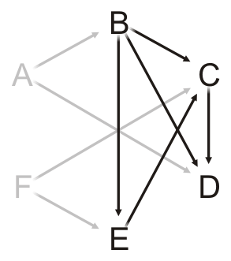
Finding the critical path
11.4.8.2
Task | In-degree | Task Time | Critical Time | Previous Task
A | 0 | 5.2 | 5.2 | Ø
B | 0 | 6.1 | 5.2 | A
C | 3 | 4.7 | 0.0 | Ø
D | 2 | 8.1 | 5.2 | A
E | 2 | 9.5 | 0.0 | Ø
F | 0 | 17.1 | 0.0 | Ø
Queue
B
Pop Task F and update its critical time 0.0 + 17.1 = 17.1

Slide 119
Finding the critical path
11.4.8.2
Task | In-degree | Task Time | Critical Time | Previous Task
A | 0 | 5.2 | 5.2 | Ø
B | 0 | 6.1 | 5.2 | A
C | 3 | 4.7 | 0.0 | Ø
D | 2 | 8.1 | 5.2 | A
E | 2 | 9.5 | 0.0 | Ø
F | 0 | 17.1 | 17.1 | Ø
Queue
B
Pop Task F and update its critical time 0.0 + 17.1 = 17.1

Slide 120
Finding the critical path
11.4.8.2
Task | In-degree | Task Time | Critical Time | Previous Task
A | 0 | 5.2 | 5.2 | Ø
B | 0 | 6.1 | 5.2 | A
C | 3 | 4.7 | 0.0 | Ø
D | 2 | 8.1 | 5.2 | A
E | 2 | 9.5 | 0.0 | Ø
F | 0 | 17.1 | 17.1 | Ø
Queue
B
For each neighbor of Task F:
Decrement the in-degree, push if necessary, and check if we must update the critical time

Slide 121
Finding the critical path
11.4.8.2
Task | In-degree | Task Time | Critical Time | Previous Task
A | 0 | 5.2 | 5.2 | Ø
B | 0 | 6.1 | 5.2 | A
C | 2 | 4.7 | 17.1 | F
D | 2 | 8.1 | 5.2 | A
E | 1 | 9.5 | 17.1 | F
F | 0 | 17.1 | 17.1 | Ø
Queue
B
For each neighbor of Task F:
Decrement the in-degree, push if necessary, and check if we must update the critical time

Slide 122
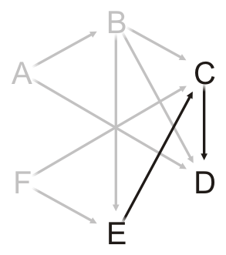
Finding the critical path
11.4.8.2
Task | In-degree | Task Time | Critical Time | Previous Task
A | 0 | 5.2 | 5.2 | Ø
B | 0 | 6.1 | 5.2 | A
C | 2 | 4.7 | 17.1 | F
D | 2 | 8.1 | 5.2 | A
E | 1 | 9.5 | 17.1 | F
F | 0 | 17.1 | 17.1 | Ø
Queue
Pop Task B and update its critical time 5.2 + 6.1 = 11.3

Slide 123
Finding the critical path
11.4.8.2
Task | In-degree | Task Time | Critical Time | Previous Task
A | 0 | 5.2 | 5.2 | Ø
B | 0 | 6.1 | 11.3 | A
C | 2 | 4.7 | 17.1 | F
D | 2 | 8.1 | 5.2 | A
E | 1 | 9.5 | 17.1 | F
F | 0 | 17.1 | 17.1 | Ø
Queue
Pop Task B and update its critical time 5.2 + 6.1 = 11.3

Slide 124
Finding the critical path
11.4.8.2
Task | In-degree | Task Time | Critical Time | Previous Task
A | 0 | 5.2 | 5.2 | Ø
B | 0 | 6.1 | 11.3 | A
C | 2 | 4.7 | 17.1 | F
D | 2 | 8.1 | 5.2 | A
E | 1 | 9.5 | 17.1 | F
F | 0 | 17.1 | 17.1 | Ø
Queue
For each neighbor of Task B:
Decrement the in-degree, push if necessary, and check if we must update the critical time

Slide 125
Finding the critical path
11.4.8.2
Task | In-degree | Task Time | Critical Time | Previous Task
A | 0 | 5.2 | 5.2 | Ø
B | 0 | 6.1 | 11.3 | A
C | 1 | 4.7 | 17.1 | F
D | 1 | 8.1 | 11.3 | B
E | 0 | 9.5 | 17.1 | F
F | 0 | 17.1 | 17.1 | Ø
Queue
E
For each neighbor of Task F:
Decrement the in-degree, push if necessary, and check if we must update the critical time
Both C and E are waiting on F

Slide 126
Finding the critical path
11.4.8.2
Task | In-degree | Task Time | Critical Time | Previous Task
A | 0 | 5.2 | 5.2 | Ø
B | 0 | 6.1 | 11.3 | A
C | 1 | 4.7 | 17.1 | F
D | 1 | 8.1 | 11.3 | B
E | 0 | 9.5 | 17.1 | F
F | 0 | 17.1 | 17.1 | Ø
Queue
Pop Task E and update its critical time 17.1 + 9.5 = 26.6

Slide 127
Finding the critical path
11.4.8.2
Task | In-degree | Task Time | Critical Time | Previous Task
A | 0 | 5.2 | 5.2 | Ø
B | 0 | 6.1 | 11.3 | A
C | 1 | 4.7 | 17.1 | F
D | 1 | 8.1 | 11.3 | B
E | 0 | 9.5 | 26.6 | F
F | 0 | 17.1 | 17.1 | Ø
Queue
Pop Task E and update its critical time 17.1 + 9.5 = 26.6

Slide 128
Finding the critical path
11.4.8.2
Task | In-degree | Task Time | Critical Time | Previous Task
A | 0 | 5.2 | 5.2 | Ø
B | 0 | 6.1 | 11.3 | A
C | 1 | 4.7 | 17.1 | F
D | 1 | 8.1 | 11.3 | B
E | 0 | 9.5 | 26.6 | F
F | 0 | 17.1 | 17.1 | Ø
Queue
For each neighbor of Task E:
Decrement the in-degree, push if necessary, and check if we must update the critical time

Slide 129
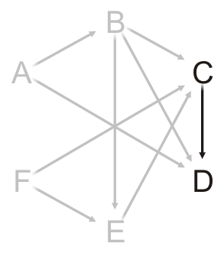
Finding the critical path
11.4.8.2
Task | In-degree | Task Time | Critical Time | Previous Task
A | 0 | 5.2 | 5.2 | Ø
B | 0 | 6.1 | 11.3 | A
C | 0 | 4.7 | 26.6 | E
D | 1 | 8.1 | 11.3 | B
E | 0 | 9.5 | 26.6 | F
F | 0 | 17.1 | 17.1 | Ø
Queue
C
For each neighbor of Task E:
Decrement the in-degree, push if necessary, and check if we must update the critical time

Slide 130
Finding the critical path
11.4.8.2
Task | In-degree | Task Time | Critical Time | Previous Task
A | 0 | 5.2 | 5.2 | Ø
B | 0 | 6.1 | 11.3 | A
C | 0 | 4.7 | 26.6 | E
D | 1 | 8.1 | 11.3 | B
E | 0 | 9.5 | 26.6 | F
F | 0 | 17.1 | 17.1 | Ø
Queue
Pop Task C and update its critical time 26.6 + 4.7 = 31.3

Slide 131
Finding the critical path
11.4.8.2
Task | In-degree | Task Time | Critical Time | Previous Task
A | 0 | 5.2 | 5.2 | Ø
B | 0 | 6.1 | 11.3 | A
C | 0 | 4.7 | 31.3 | E
D | 1 | 8.1 | 11.3 | B
E | 0 | 9.5 | 26.6 | F
F | 0 | 17.1 | 17.1 | Ø
Queue
Pop Task C and update its critical time 26.6 + 4.7 = 31.3

Slide 132
Finding the critical path
11.4.8.2
Task | In-degree | Task Time | Critical Time | Previous Task
A | 0 | 5.2 | 5.2 | Ø
B | 0 | 6.1 | 11.3 | A
C | 0 | 4.7 | 31.3 | E
D | 1 | 8.1 | 11.3 | B
E | 0 | 9.5 | 26.6 | F
F | 0 | 17.1 | 17.1 | Ø
Queue
For each neighbor of Task C:
Decrement the in-degree, push if necessary, and check if we must update the critical time

Slide 133
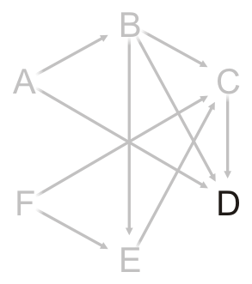
Finding the critical path
11.4.8.2
Task | In-degree | Task Time | Critical Time | Previous Task
A | 0 | 5.2 | 5.2 | Ø
B | 0 | 6.1 | 11.3 | A
C | 0 | 4.7 | 31.3 | E
D | 0 | 8.1 | 31.3 | C
E | 0 | 9.5 | 26.6 | F
F | 0 | 17.1 | 17.1 | Ø
Queue
D
For each neighbor of Task C:
Decrement the in-degree, push if necessary, and check if we must update the critical time

Slide 134
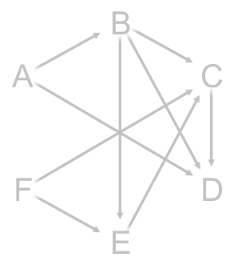
Finding the critical path
11.4.8.2
Task | In-degree | Task Time | Critical Time | Previous Task
A | 0 | 5.2 | 5.2 | Ø
B | 0 | 6.1 | 11.3 | A
C | 0 | 4.7 | 31.3 | E
D | 0 | 8.1 | 31.3 | C
E | 0 | 9.5 | 26.6 | F
F | 0 | 17.1 | 17.1 | Ø
Queue
Pop Task D and update its critical time 31.3 + 8.1 = 39.4

Slide 135
Finding the critical path
11.4.8.2
Task | In-degree | Task Time | Critical Time | Previous Task
A | 0 | 5.2 | 5.2 | Ø
B | 0 | 6.1 | 11.3 | A
C | 0 | 4.7 | 31.3 | E
D | 0 | 8.1 | 39.4 | C
E | 0 | 9.5 | 26.6 | F
F | 0 | 17.1 | 17.1 | Ø
Queue
Pop Task D and update its critical time 31.3 + 8.1 = 39.4

Slide 136
Finding the critical path
11.4.8.2
Task | In-degree | Task Time | Critical Time | Previous Task
A | 0 | 5.2 | 5.2 | Ø
B | 0 | 6.1 | 11.3 | A
C | 0 | 4.7 | 31.3 | E
D | 0 | 8.1 | 39.4 | C
E | 0 | 9.5 | 26.6 | F
F | 0 | 17.1 | 17.1 | Ø
Queue
Task D has no neighbors and the queue is empty
We are done

Slide 137
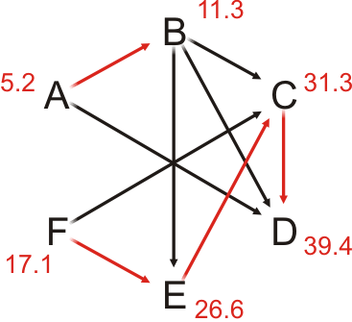
Finding the critical path
11.4.8.2
Task | In-degree | Task Time | Critical Time | Previous Task
A | 0 | 5.2 | 5.2 | Ø
B | 0 | 6.1 | 11.3 | A
C | 0 | 4.7 | 31.3 | E
D | 0 | 8.1 | 39.4 | C
E | 0 | 9.5 | 26.6 | F
F | 0 | 17.1 | 17.1 | Ø
Task D has no neighbors and the queue is empty
We are done

Slide 138
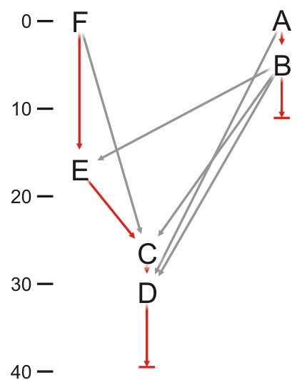
Finding the critical path
11.4.8.2
Task | In-degree | Task Time | Critical Time | Previous Task
A | 0 | 5.2 | 5.2 | Ø
B | 0 | 6.1 | 11.3 | A
C | 0 | 4.7 | 31.3 | E
D | 0 | 8.1 | 39.4 | C
E | 0 | 9.5 | 26.6 | F
F | 0 | 17.1 | 17.1 | Ø
We can also plot the completing of the tasks tasks in time
We need to be able to execute two tasks in parallel for this example

Slide 139
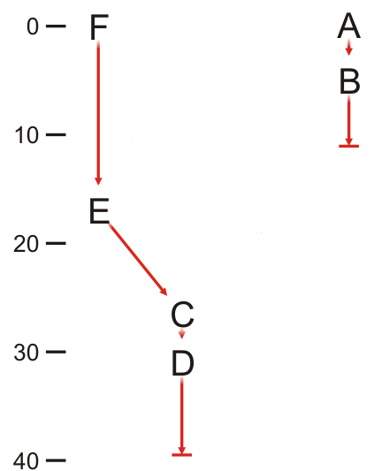
Finding the critical path
11.4.8.2
Task | Previous Task
A | Ø
B | A
C | E
D | C
E | F
F | Ø
Incidentally, the task and previous task defines a forest using the parental tree data structure

Slide 140
Summary
In this topic, we have discussed topological sorts
Sorting of elements in a DAG
Implementation
A table of in-degrees
Select that vertex which has current in-degree zero
We defined critical paths
The implementation requires only a few more table entries

Slide 141
References
Wikipedia, http://en.wikipedia.org/wiki/Topological_sorting
[1] Cormen, Leiserson, and Rivest, Introduction to Algorithms, McGraw Hill, 1990, §11.1, p.200.
[2] Weiss, Data Structures and Algorithm Analysis in C++, 3rd Ed., Addison Wesley, §9.2, p.342-5.
These slides are provided for the ECE 250 Algorithms and Data Structures course. The material in it reflects Douglas W. Harder’s best judgment in light of the information available to him at the time of preparation. Any reliance on these course slides by any party for any other purpose are the responsibility of such parties. Douglas W. Harder accepts no responsibility for damages, if any, suffered by any party as a result of decisions made or actions based on these course slides for any other purpose than that for which it was intended.

